Slide 1
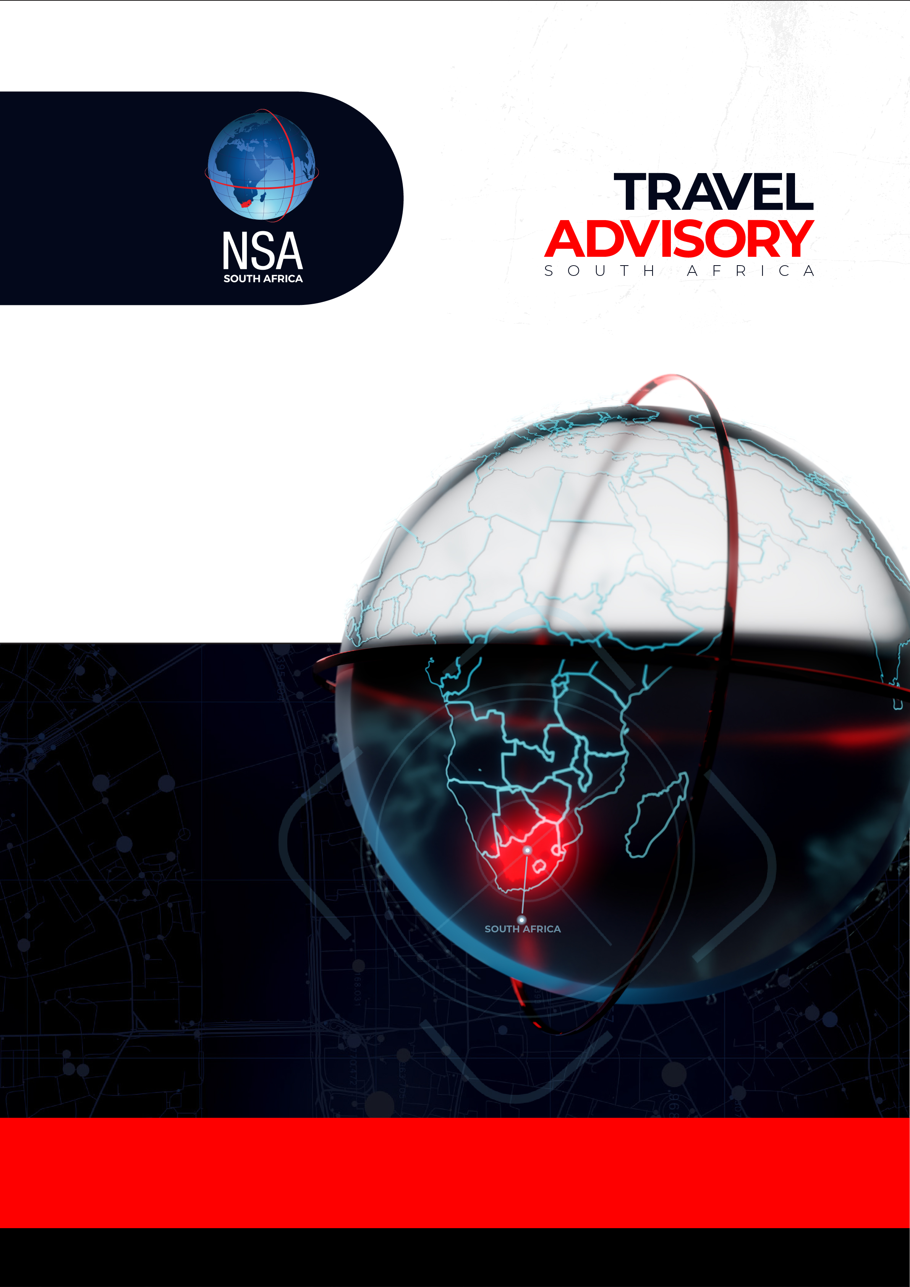
NSA SA PROFILE
SPECIALISED SECURITY SOLUTIONS
IN AN EVOLVING WORLD OF LOCAL, REGIONAL AND GLOBAL THREATS

Slide 2

ABOUT THE NSA GROUP OF COMPANIES
Introduction to the NSA Group:
The NSA Global Group is a leader in the specialised security services market worldwide, delivering best-in-class protective solutions to multinational corporations, government entities, and high-net-worth individuals. With a global footprint that includes strategic offices in South Africa, India, and Dubai, we provide our clients with world-class security services, seamlessly integrated with cutting-edge technology and intelligence-led operations.
GROUP OF COMPANIES
NSA Security Consultants SA, headquartered in Johannesburg, serves as the foundation of the Group’s presence on the African continent. For almost three decades, we have been trusted by Fortune 500 companies, NGOs, and private clients to deliver sophisticated, bespoke security solutions across South Africa and beyond. Our services — from executive protection and tactical support to armed goods escorts, guarding, and security consultancy — are tailored to meet the complex and evolving needs of our clients operating in one of the world’s most dynamic environments.
Our success is underpinned by a relentless focus on quality, compliance, and technological innovation. Supported by our 24/7 General Security Operations Centre (GSOC) and a highly experienced management team, NSA South Africa ensures that every deployment is executed to the highest international standards, providing our clients with certainty, resilience, and complete peace of mind.
At NSA, we set the benchmark for specialised security services in South Africa.
NSA Global
NSA India
NSA Middle East
NSA South Africa
NSA V
SLA Paramedics
NSA Tactical
NSA Secure Drive

Slide 3
WHY CHOOSE NSA
Choosing NSA Security Consultants SA means partnering with a security provider that consistently delivers excellence without compromise. With nearly three decades of operational success, a global footprint, and a client base that includes Fortune 500 companies, NGOs, governments, and high-net-worth individuals, NSA is regarded as one of the most capable and trusted specialised security firms in the industry.
Here’s why discerning clients choose NSA:
1. Proven Track Record
With a heritage dating back to 1999, NSA has consistently delivered high-level protective services in some of the most challenging environments across Africa, the Middle East, and Asia. Our reputation has been built on discretion, precision, and results.
2. Elite Personnel
We maintain strict selection and training standards across all service lines — from executive protection to guarding and tactical support. Our personnel are vetted, accredited, and continuously upskilled to operate at the highest level of professionalism and effectiveness.
3. Technology-Driven Operations
NSA integrates advanced technology into every aspect of our service delivery. From live tracking and telemetry to GSOC-based oversight, we ensure real-time intelligence, situational awareness, and dynamic response capabilities.
4. GSOC Command & Control
Our 24/7 General Security Operations Centre (GSOC) provides centralised coordination, intelligence support, and command and control for all NSA deployments. This infrastructure ensures a higher standard of service delivery, faster escalation, and enhanced client confidence.
5. Client-Centric Approach
At NSA, our mission is to safeguard what matters most to our clients — their people, their operations, their reputation. Every task is approached with integrity, precision, and an unwavering commitment to excellence.
Commitment to Compliance, Ethics & Integrity
NSA places the highest priority on legal and statutory compliance, operating fully in line with the Private Security Industry Regulatory Authority (PSIRA) and all applicable South African legislation. Beyond legal adherence, we hold ourselves to strict ethical standards, ensuring that our conduct reflects the trust placed in us by our clients, stakeholders, and the communities in which we operate.
We believe that the true strength of a security partner lies not only in capability, but in moral stature, transparency, and principled decision-making — values that are embedded in our organisational culture and daily operations.

Slide 4
OUR SERVICE OFFERING
Executive protection services
Travel security and journey management
Secure Drive point to point transfers
Tactical support services
Executive guarding
Risk management consultancy

Slide 5
EXECUTIVE PROTECTION
NSA Security Consultants SA is one of the most recognised and respected brands in the provision of Executive Protection services in South Africa. For over two decades, we have been entrusted with the personal safety of high-profile individuals, corporate executives, government officials, diplomats, and other clients who require discreet, high-level protection in both day-to-day and high-threat environments.
Our Executive Protection Division supports a broad range of clients, including:
Individuals deemed to be at heightened risk due to their public profile, occupation, or personal circumstances;
Institutional clients where protective services are mandated by internal policy or regulatory frameworks;
Visiting dignitaries, business leaders, and delegations operating in complex or unfamiliar environments.
Our capabilities extend well beyond the traditional bodyguard model. NSA protection teams are strategically selected and rigorously trained to operate with a high degree of discretion, cultural awareness, and situational intelligence. Our operators are supported by live intelligence feeds, advanced logistics planning, and our 24/7 Global Security Operations Centre (GSOC), ensuring real-time oversight and rapid response.
Each assignment begins with meticulous pre-task planning — including route mapping, threat identification, logistical coordination, and contingency analysis — to ensure the seamless delivery of services and optimal comfort for our clients at all times.
Every executive protection engagement is tailored to the unique risk profile of the client, and may include protective driving, residential security, travel security planning, location assessments, and medical support capabilities where required.
NSA is not just a provider of security — we are a trusted partner in the ongoing preservation of life, reputation, and operational continuity.

Slide 6
TRAVEL SECURITY & JOURNEY MANAGEMENT
NSA Security Consultants SA offers a fully integrated Travel Security and Journey Management solution, designed to ensure the safety, continuity, and comfort of our clients throughout every phase of their travel.
We provide end-to-end operational support, combining advanced logistics, elite manpower, and real-time intelligence. Our service is trusted by global executives, diplomats, and high-profile individuals who require absolute discretion, reliability, and operational precision.
Our Core Services Include:
Vehicle Logistics: Deployment of a diverse fleet of vehicles aligned to client preferences — including luxury sedans, SUVs, and armoured platforms — each supported by secure scheduling and real-time tracking.
Manpower Provision: Scalable deployment of trained Close Protection Officers, Security Drivers, and support teams to ensure appropriate coverage and layered protection based on the client’s threat profile and operational environment.
Itinerary Planning & Journey Design: Comprehensive route planning, site reconnaissance, accommodation vetting, and scheduling — tailored to each journey and adapted dynamically based on ground conditions and client requirements.
GSOC Integration: Our dedicated General Security Operations Centre (GSOC) provides 24/7 mission support, including:
  Live tracking of vehicles and personnel
  Frequent updates to client stakeholders
  Real-time flight tracking and movement monitoring
  Threat intelligence alerts sent directly to personnel for on-the-ground decision-making
  Constant communication and oversight of all task-related activities
At the core of our service is a seasoned management and coordination team with multiple decades of collective experience in delivering complex, high-risk travel security assignments. Their expertise ensures flawless execution, proactive mitigation of emerging threats, and operational confidence for our clients wherever they go.
NSA does more than facilitate secure movement — we enable our clients to operate globally with confidence, continuity, and control.

Slide 7
NSA SECURE DRIVE
Add one pager from our Secure Drive brochure.

Slide 8
TACTICAL SUPPORT
NSA Security Consultants SA provides a robust Tactical Support capability, delivering both static tactical officers and mobile tactical response teams to protect high-risk, high-value locations across South Africa. Our deployments are designed to deter criminal activity, stabilize volatile environments, and respond with precision and speed in the event of any security incident.
Our tactical personnel are hand-selected, thoroughly vetted, and trained to the highest standards. All of our officers undergo ongoing upskilling to ensure readiness for complex and evolving threat scenarios.
Tactical Capabilities Include:
Static Tactical Officers: Deployed to safeguard facilities, infrastructure, or sensitive locations requiring elevated protection and an overt security presence.
Mobile Tactical Teams: Rapid-response units trained to react immediately to incidents, conduct proactive patrols, and support broader anti-crime operations in coordination with local enforcement and stakeholders.
Every deployment is underpinned by intelligence-led planning and reinforced through the strategic use of technology, including:
Surveillance tools and perimeter monitoring systems
Live tracking and telemetry support
Remote communications and incident logging platforms
All tactical operations are supported by NSA’s 24/7 Global Security Operations Centre (GSOC) — a centralised hub for command, control, communications, and intelligence dissemination. The GSOC ensures seamless coordination, immediate incident escalation, and real-time operational oversight.
At NSA, our Tactical Support Division is more than a reactive solution — it is a preventative force, an intelligence-informed capability, and a critical layer in the protection of people, property, and business continuity.

Slide 9
EXECUTIVE GUARDING
NSA Security Consultants SA offers a premium Executive Guarding service, purpose-built for environments where the highest standards of professionalism, discretion, and situational awareness are non-negotiable. Our guarding division is trusted to secure executive residences, corporate headquarters, luxury retail boutiques, and other high-value or strategically sensitive locations.
Unlike conventional guarding services, NSA deploys only top-tier personnel — carefully selected, thoroughly vetted, and trained to operate in environments where client expectations exceed industry norms. Our guards undergo continuous professional development and site-specific training to ensure that their presence adds value, not just visibility.
Deployed To:
Executive and diplomatic residences
Corporate headquarters
High-end retail stores and boutique outlets
Secure office parks and premium mixed-use developments
Each deployment is backed by NSA’s 24/7 General Security Operations Centre (GSOC), which provides:
Live monitoring and incident escalation
Direct communications with on-site personnel
Intelligence alerts and situational updates
Quality assurance through real-time oversight
Our Executive Guards are more than a physical presence — they are ambassadors of your security strategy, equipped with the training, technology, and professionalism to protect people, property, and reputation with integrity and composure.
NSA’s Executive Guarding division sets a new benchmark in the industry — combining elite manpower with live intelligence and operational oversight to deliver protection that’s a cut above the rest.

Slide 10
RISK MANAGEMENT CONSULTANCY
NSA Security Consultants SA provides a comprehensive Risk Management Consultancy service, designed to help clients identify vulnerabilities, mitigate threats, and build resilient security frameworks. Our consultancy division is made up of a diverse team of multi-disciplinary experts with backgrounds in intelligence, law enforcement, cybersecurity, and corporate security management.
We work with corporations, governments, NGOs, and high-net-worth individuals to assess and secure critical assets — both physical and digital — through a proactive, intelligence-led approach.
Our Consultancy Services Include:
Threat, Risk & Vulnerability Assessments (TRVA)
In-depth analysis of sites, systems, and people to identify weaknesses and recommend tailored mitigation strategies.
Security Audits
Comprehensive reviews of existing security policies, infrastructure, and practices to evaluate compliance, effectiveness, and risk exposure.
Penetration Testing & Red Teaming
Controlled, simulated attacks to assess the real-world resilience of physical security protocols and access control systems.
Cybersecurity Advisory
Strategic consultation on digital risk, including network vulnerabilities, data protection strategies, incident response protocols, and cyber hygiene.
High-Level Investigations
Confidential and discreet investigations into internal fraud, misconduct, security breaches, or external threats — supported by forensics and legal coordination where required.
Our consultants operate under strict confidentiality protocols and are supported by NSA’s 24/7 General Security Operations Centre (GSOC), which provides real-time intelligence and operational integration where necessary.
NSA’s consultancy services go beyond theory — we deliver actionable insights, executable plans, and measurable outcomes. Whether you're looking to harden your infrastructure, validate your security posture, or navigate a complex threat environment, NSA provides the intelligence, experience, and discretion to help you stay ahead of risk.

